Slide 1
NATIONAL APPRENTICESHIP WEEK 7-13 FEBRUARY 2022

Slide 2
What are you are going to discover this week?
What apprenticeships are?
The different levels and entry requirements, including Higher and Degree Apprenticeships
Types of industries that employ apprentices
Discover opportunities and where to find them
Test your knowledge

Slide 3
Monday Useful websites https://amazingapprenticeships.com/ https://www.ratemyapprenticeship.co.uk/ https://www.ucas.com/understanding-apprenticeships
Introduction to Apprenticeships
https://www.youtube.com/watch?v=mkQ_BkSZlkU
13 mins, please skip ads
Available from Careers library

Slide 4
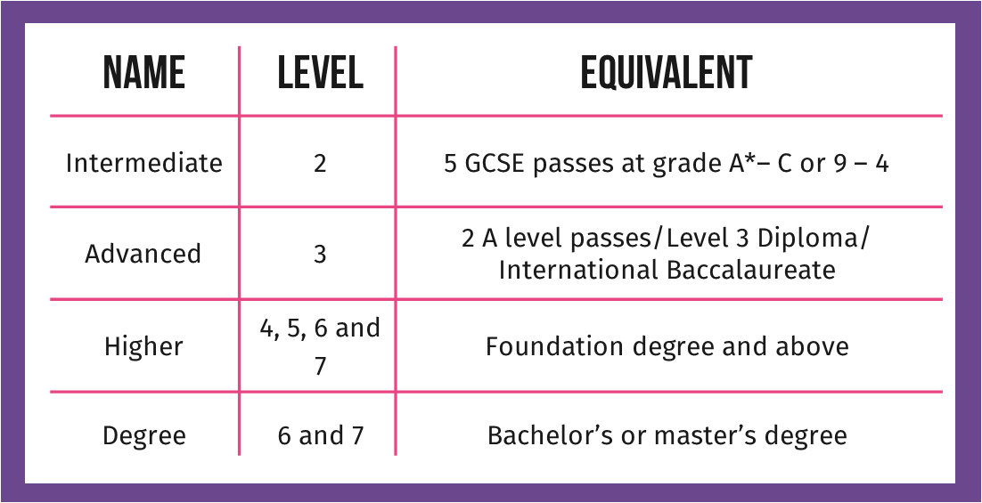
Tuesday Useful Websites https://successatschool.org/advicedetails/582/degree-apprenticeships https://www.ucas.com/apprenticeships/what-you-need-know-about-apprenticeships/degree-apprenticeships-0 https://www.prospects.ac.uk/jobs-and-work-experience/apprenticeships/degree-apprenticeships
Apprentices are amazing
https://amazingapprenticeships.com/resource/apprentices-are-amazing-film/
1.26 min
Higher and Degree Apprenticeships
https://youtu.be/IiTNP8E7jHg
2.01min

Slide 5
Wednesday & Thursday
https://amazingapprenticeships.com/resources/?films=1
Drama & Music
Art & Design
Geography
Food & Nutrition
English
Business
History
Maths
ICT & Computing
Language
PE & Sport
Science
Inspiration, how you can use your subjects at school
Your class can choose all or some of the videos to watch over the next 2 days, each one is approx. 1.25mins

Slide 6
Friday Quiz time. You choose which quiz or several to complete as class
Test your knowledge
Guess the Employer
https://amazingapprenticeships.com/resource/guess-the-employer-quiz/ - 15 questions
The Apprenticeship Quiz 2022
https://amazingapprenticeships.com/resource/the-apprenticeship-quiz-2022/ - 10 questions
Which Apprenticeship am I?
https://amazingapprenticeships.com/resource/naw2021-which-apprenticeship-am-i-quiz/ - 10 questions

